Slide 1
CREATING A WEBPAGE WITH html & CSS
What is html?
Html – hypertext markup language and it is a standard protocol for formatting and displaying documents on the world wide web.
There are Many parts of a website but the HTML document provides the structure (The skeleton of your webpage)
Notes:
Simply put, it is the content of your webpage

Slide 2
CREATING A WEBPAGE WITH html & CSS
The first thing you will need to do is open google chrome and install some professional development tools:
1- visual studio code and 2- Live Server

Slide 3
CREATING A WEBPAGE WITH html & CSS
Google:
https://code.visualstudio.com/
Notes:
The great news is that they are both free, and web developers love free stuff!

Slide 4
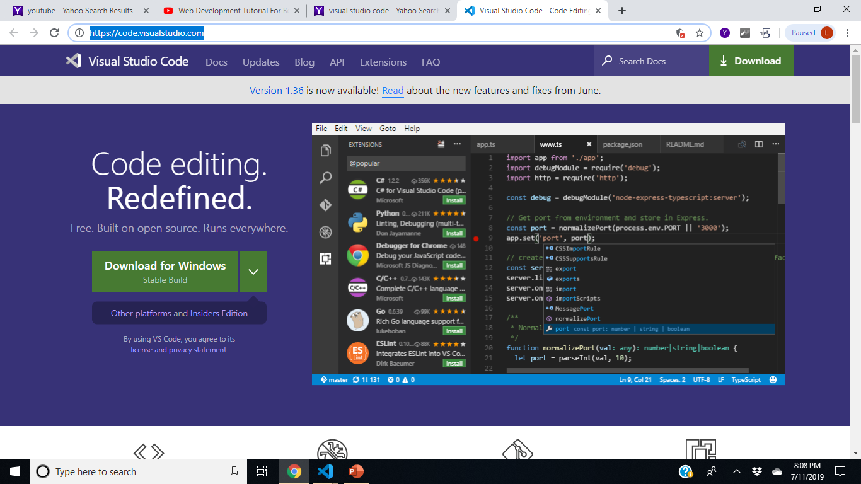
CREATING A WEBPAGE WITH HTML
Notes:
This is one of the best and most popular code text editors widely used by web developers today

Slide 5
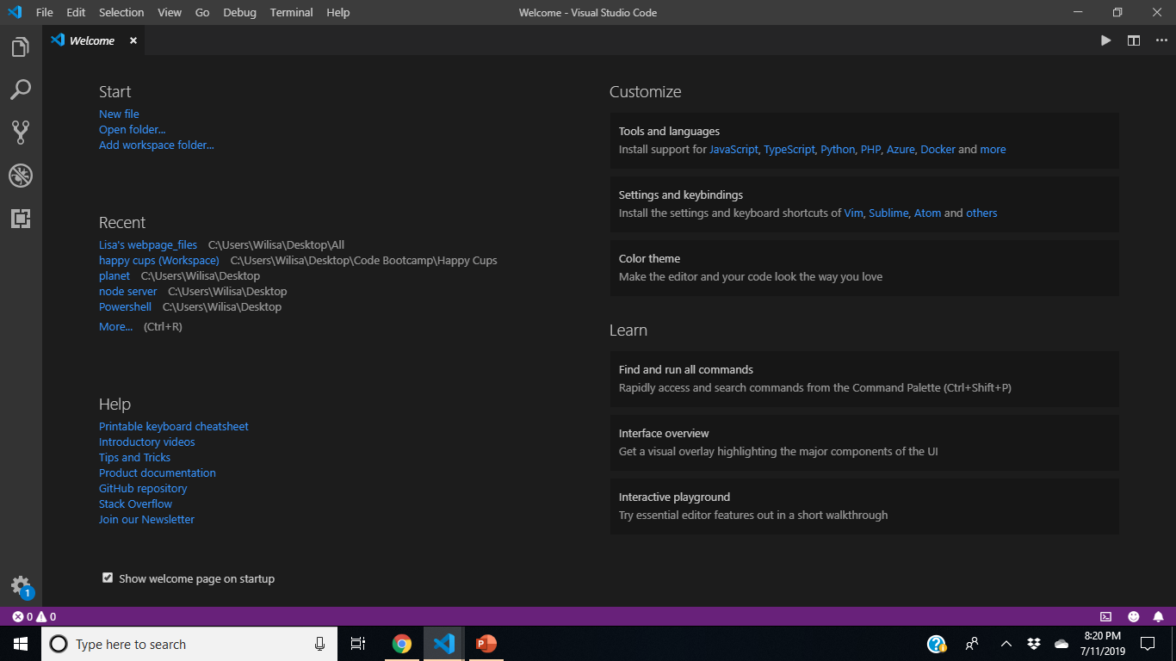
CREATING A WEBPAGE WITH HTML
Notes:
You should see something like this. Once here, click on the little square in the tool browser window to the left. Once you do so, you will see a list of free extensions you can download. The one that we want is called Live Server. Go ahead and type that in in the search box located at the top left and click the first one (5.6 1 version).

Slide 6
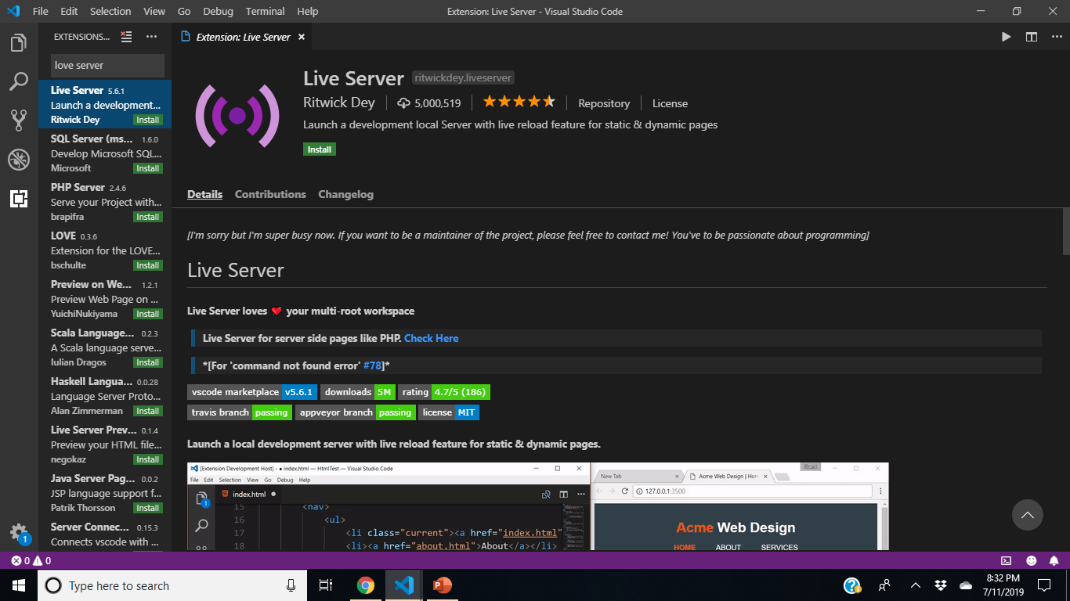
CREATING A WEBPAGE WITH HTML
Notes:
You should see something like this. Install and refresh the page. Now we are ready to code with this wonderful tool!

Slide 7
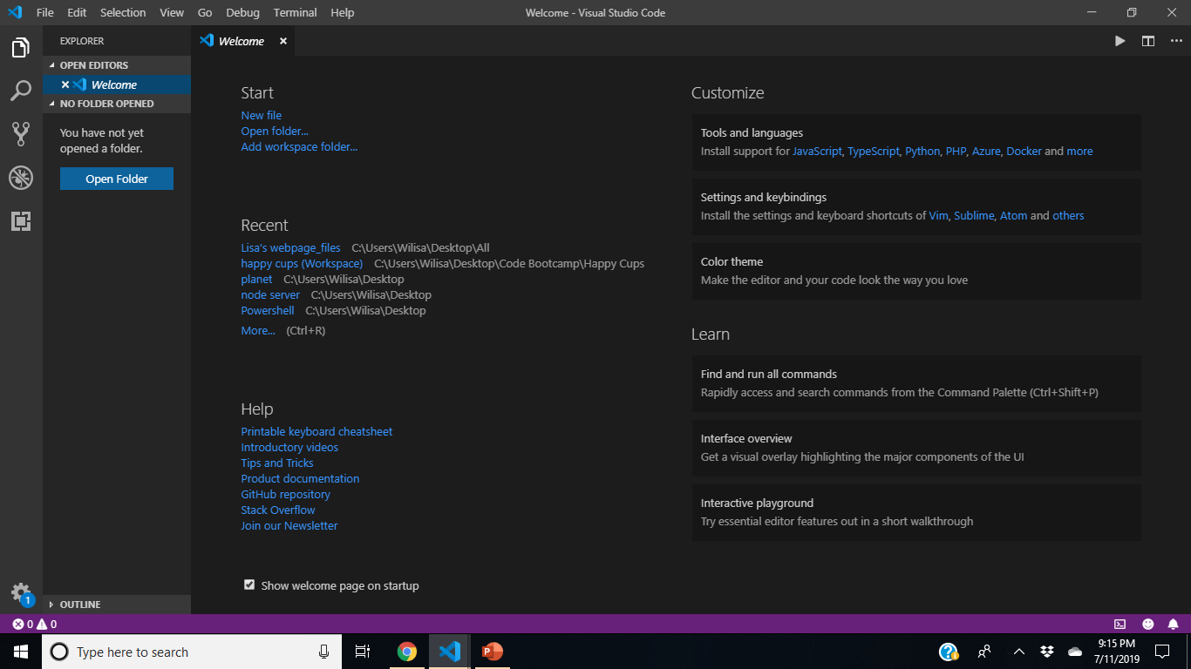
CREATING A WEBPAGE WITH HTML
Notes:
Let’s create our first super ugly webpage! You should see this. Click on the files in the tool browser window in the top left corner. It basically looks like this because it’s waiting for you to open a root folder where you can maintain the files that you will be working on for this project folder. I already have one saved on my desktop called website that I will be using. Click on open folder and find the folder you named for this project.

Slide 8
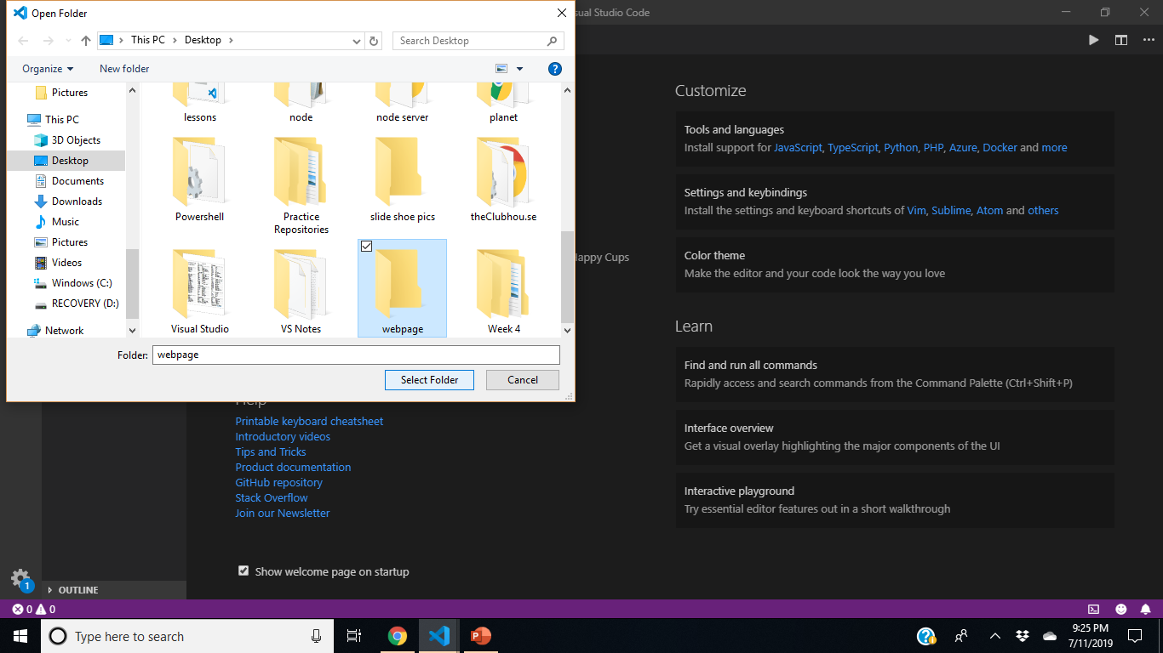
Notes:
Highlight your folder by only clicking it once.

Slide 9
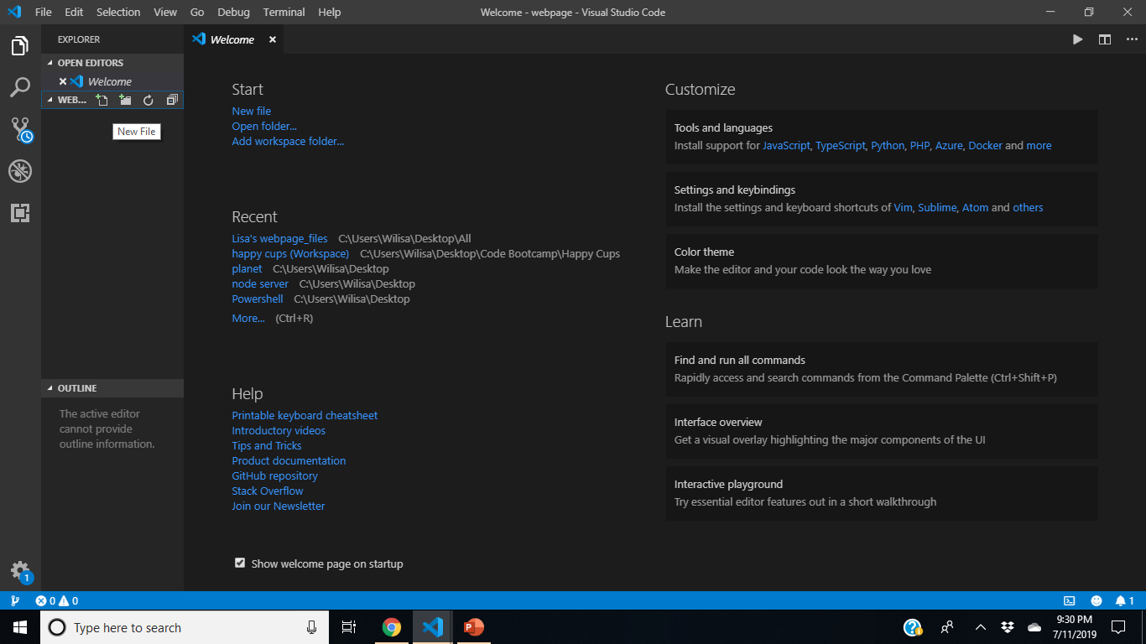

Notes:
Your new file is added here

Slide 10
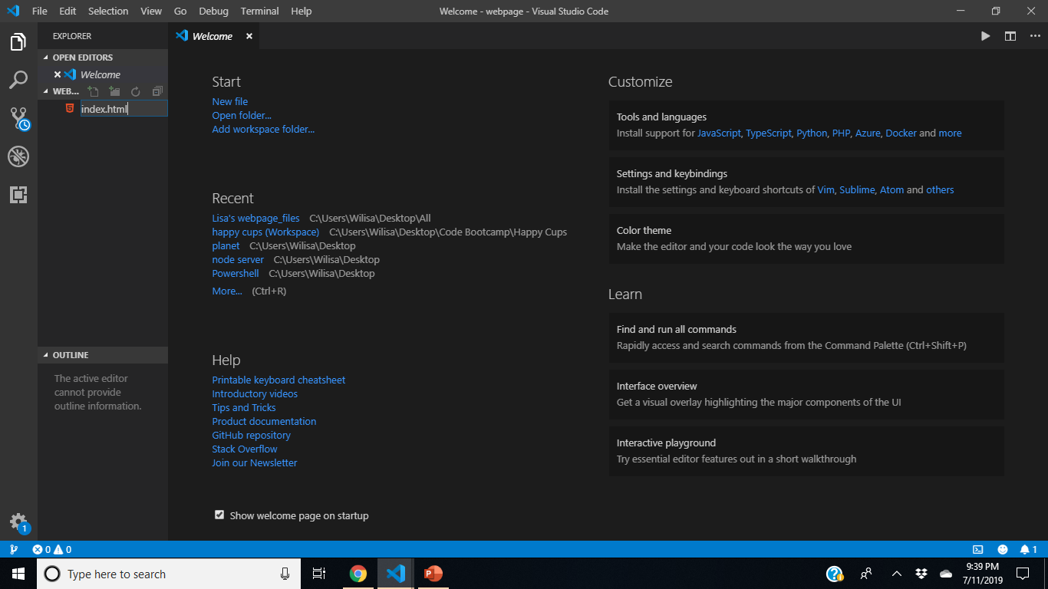
Notes:
Click and name the file. We always want to name the first file index.html. This will be the name for all of your home pages when you create a website.

Slide 11
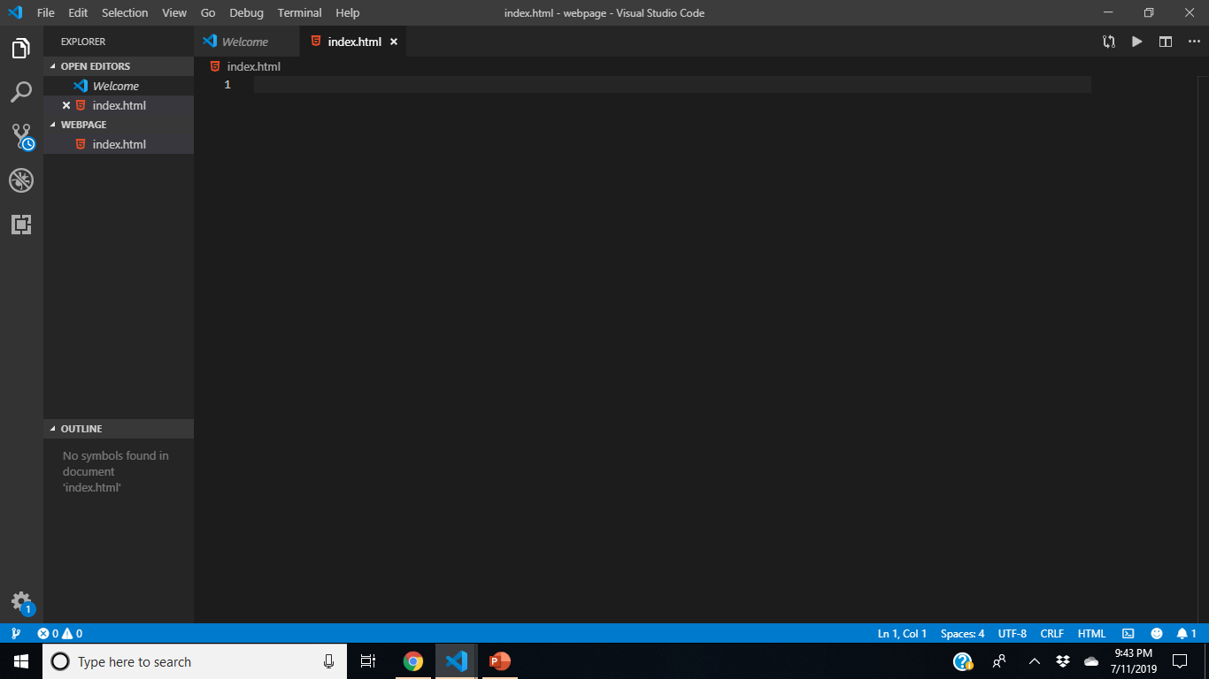
Notes:
This is what you should see. Click inside the grey box next to the number #1 – Then, Shift ! Tab Button

Slide 12
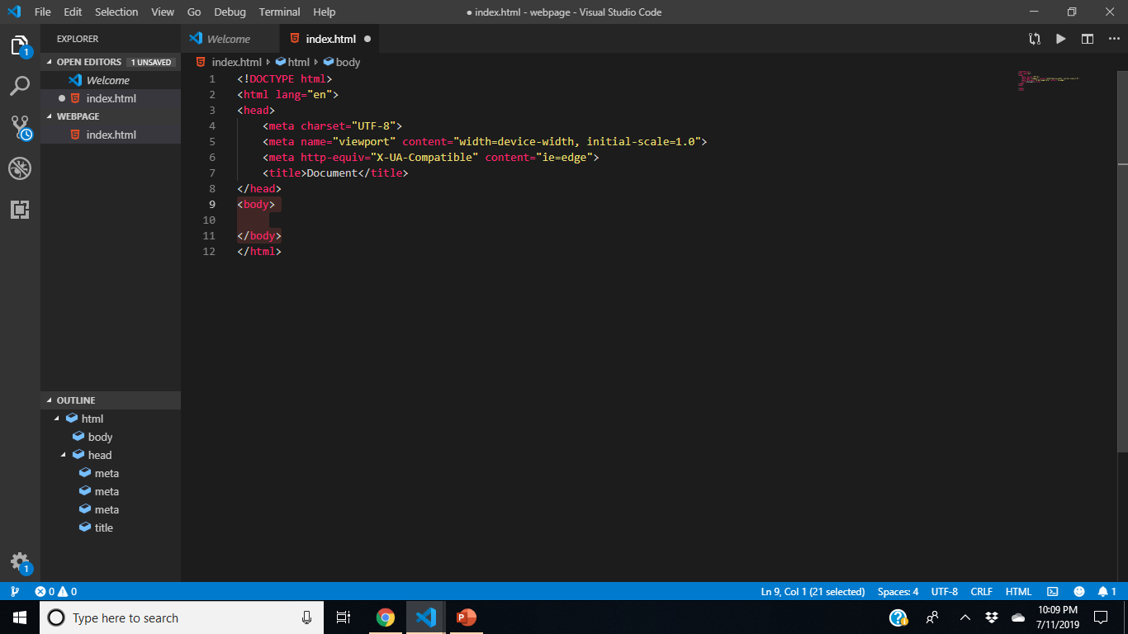
Don’t freak out! You have just created the HTML code boilerplate for your website!
Boilerplate is just another fancy word for Template! ☺
Notes:
Don’t freak out! You have just created the template for your website! Now, before we go any further, let’s break down this template and its parts. Veronica is going to explain what this code means

Slide 13
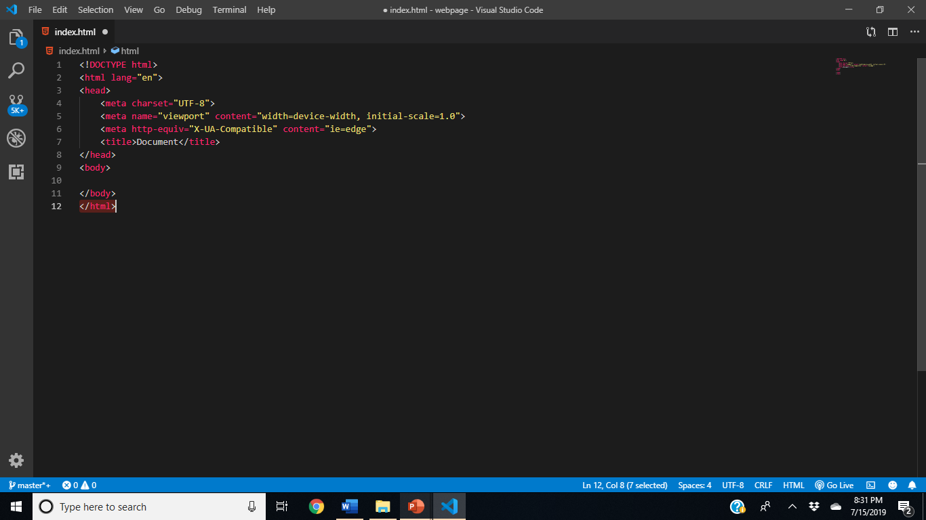
CREATING A WEBPAGE WITH HTML
<!DOCTYPE html> Tells a browser such as internet explorer, Google chrome, or safari that the document it is about to read is an html document

Slide 14
CREATING A WEBPAGE WITH HTML
html It is the root of the html document

Slide 15
CREATING A WEBPAGE WITH HTML
HEAD provides metadata (Data about the Data)

Slide 16

CREATING A WEBPAGE WITH HTML
Delete everything in the highlighted boxes

Slide 17
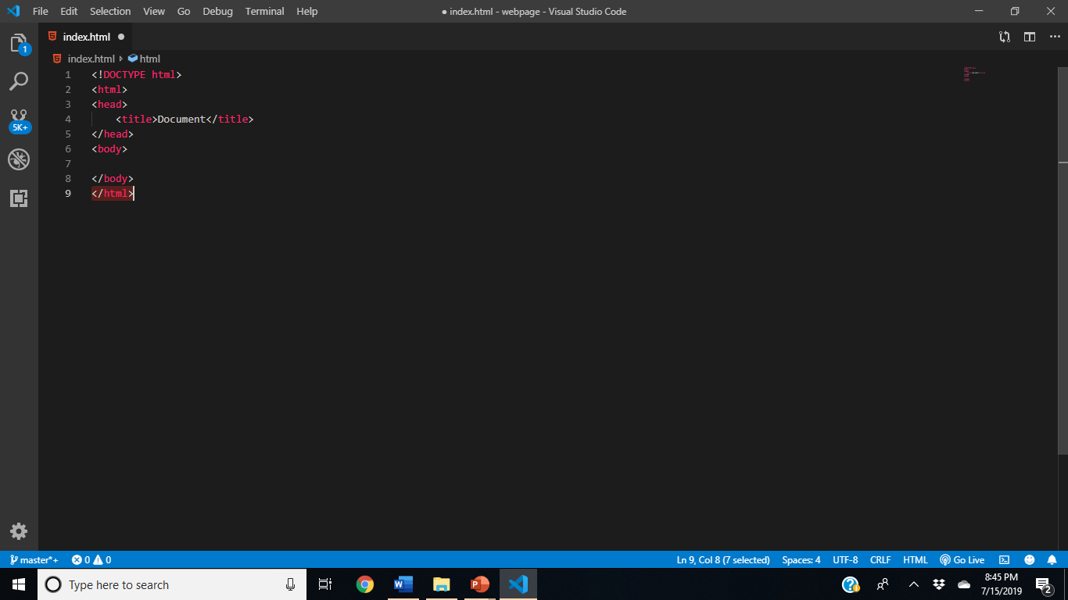
CREATING A WEBPAGE WITH HTML
Your Code should now look like this
Notes:
You have to have an HTML tag, you have to have a head tag inside of that, and you need a body tag

Slide 18
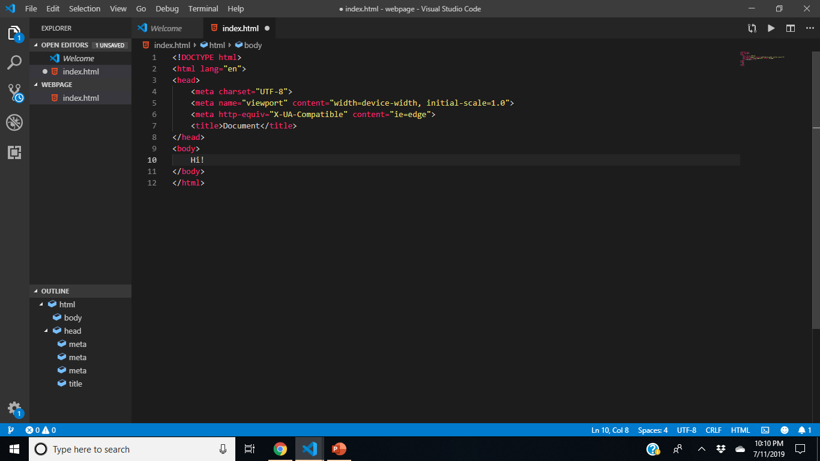
Notes:
Let’s test out our code by ensuring it shows up on live server – Type the word, Hi in between the opening and closing body tags like so

Slide 19
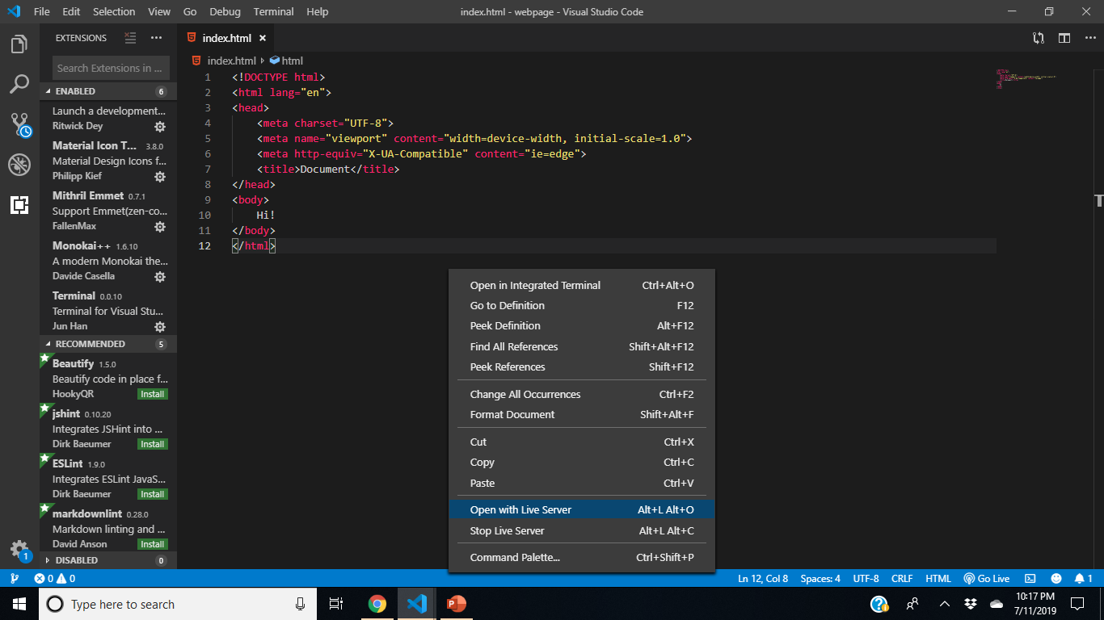
Notes:
Right click and scroll down the list to click, “Open with Live Server”

Slide 20
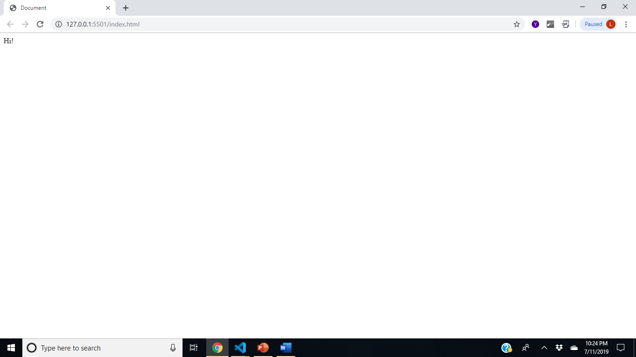
Voila!!
Notes:
You should see this, and we can tell it worked! Every time you want to check what you add, save your work by pressing, ctrl S in your index.html page and then check live server.

Slide 21
CREATING A WEBPAGE WITH html & CSS
To build an html webpage, you Specifically need to have these 3 tags to start out with:
Notes:
You need to have an HTML tag, you need to have a head tag inside of that, and you need a body tag

Slide 22
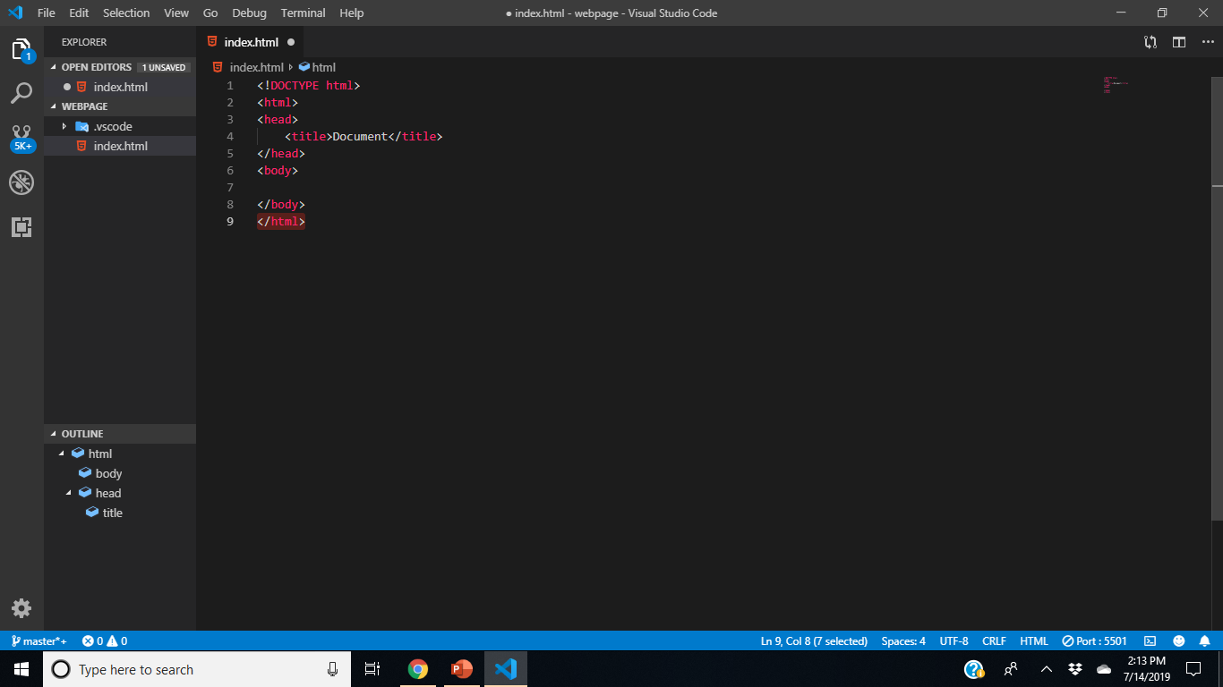

CREATING A WEBPAGE WITH HTML
Notes:
List and unordered list tags are very important in HTML. These tags are used for things like top navigating on your website. In our webpage example, I have a UL tag with unordered bulleted list items inside of it. So this basically creates a list of items, and then you can use CSS to style that list any way you want.

Slide 23
CREATING A WEBPAGE WITH html & CSS
THE BODY

Slide 24
CREATING A WEBPAGE WITH html & CSS
Everything that you view on a website is created within the body of your HTML code. The following slide provides html fundamentals you need to create your page

Slide 25
CREATING A WEBPAGE WITH html & CSS
You’ll see exactly what I mean in a few minutes!
HTML is the easiest language piece to learn out of CSS and JavaScript. You can basically learn the basics in an hour or two because all you need to memorize are a few words. Everything in HTML is considered a tag, an image or an attribute. Tags consist of the greater than sign, the tag name, any attributes, and the less than sign:
< > </ > In an HTML document these symbols are called tags
< > opening tag
</ > closing tag
Anything that is typed between the opening and closing tag is considered inside of a tag
There are also self-closing tags:
<img/>
<br/>
Notes:
Now that we got some of the basic HTML terminology out of the way, let’s

Slide 26
CREATING A WEBPAGE WITH html & CSS
HTML Text style tags
The h1-h6 are used as HTML Text style tags. H1 and h2 are your header tags and the rest are section sub-title tags. by default The higher in number you go the smaller the text.

Slide 27
CREATING A WEBPAGE WITH html & CSS
List and Unordered List Tags
(ul’s) and (li’s)
Notes:
List and unordered list tags are very important in HTML. These tags are used for things like top navigating on your website. In our webpage example, I have a UL tag with unordered bulleted list items inside of it. So this basically creates a list of items, and then you can use CSS to style that list any way you want.

Slide 28
CREATING A WEBPAGE WITH html & CSS
List and unordered list tags are very important in HTML. These tags are used for things like top navigating on your website.
Notes:
List and unordered list tags are very important in HTML. These tags are used for things like top navigating on your website. In our webpage example, I have a UL tag with unordered bulleted list items inside of it. So this basically creates a list of items, and then you can use CSS to style that list any way you want.

Slide 29
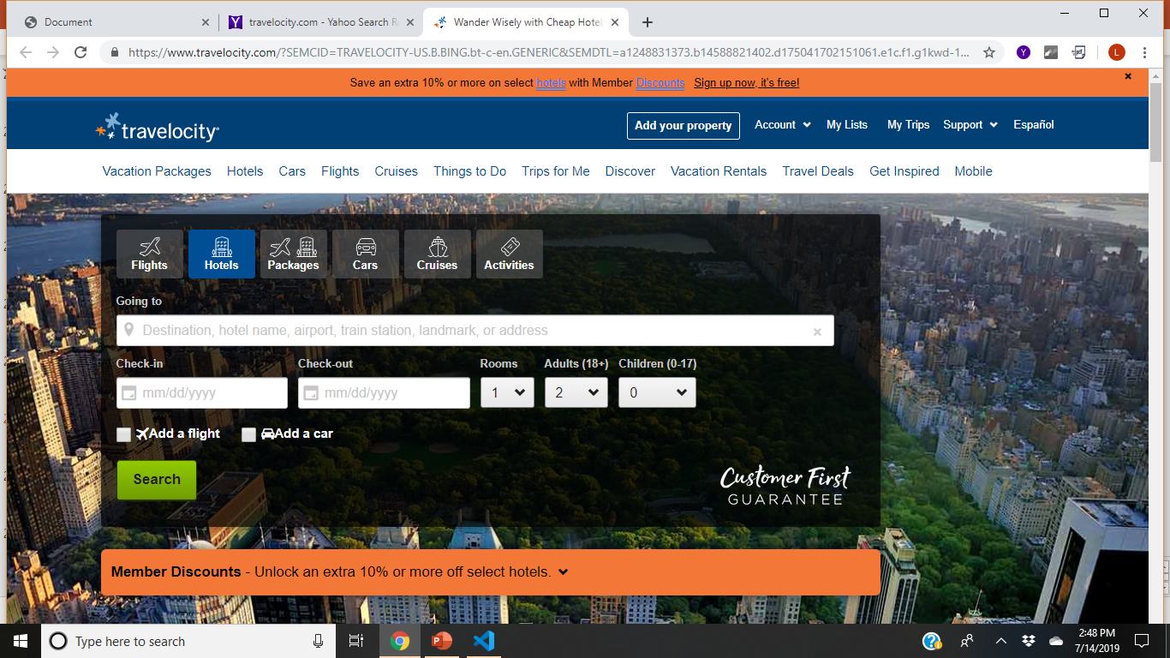
CREATING A WEBPAGE WITH HTML
Notes:
Here’s an example

Slide 30
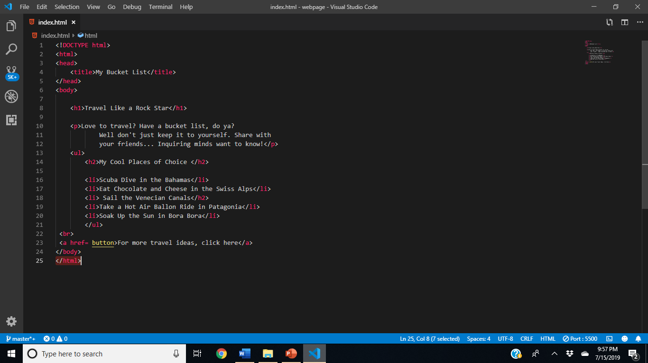
CREATING A WEBPAGE WITH CSS

Slide 31
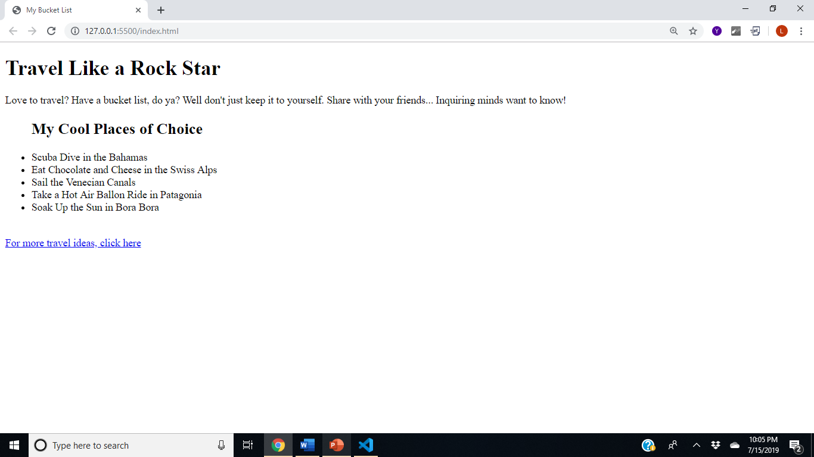
CREATING A WEBPAGE WITH HTML
Notes:
And there you have it! We’ve created our very first and simple webpage with some basic HTML code fundamentals! Too easy, right? Now you can use CSS to style that list any way you want and Kat is up next to explain how you do this.

Slide 32
CREATING A WEBPAGE WITH html & CSS
What is CSS?
Cascading Style Sheet

Slide 33
CREATING A WEBPAGE WITH html & CSS
How Does CSS Work?
It interacts with HTML elements(individual components of a web page)
Such as the <h1>, <ol>, <ul>, <li> & <p>
We use these elements as selectors in CSS
Element in HTML: <h1> My Bucket List </h1>
Selector in CSS: h1 { }

Slide 34
CREATING A WEBPAGE WITH html & CSS
External vs Internal
You still use a text editor to write CSS.
There are 3 Ways

Slide 35
CREATING A WEBPAGE WITH html & CSS
RESUSE vs REWRITE
Rewrite = Internal and Inline
Internal style sheets and inline style can be used on a case by case basis when individual style changes need to be made.
Reuse = External
The most efficient method for implementing CSS on a website (it’s easier to keep track of and implement a site’s style from a dedicated CSS file).

Slide 36
CREATING A WEBPAGE WITH html & CSS
External style sheets are saved as .CSS
Let’s create one now!
Using VS Code
Create a New File
Call it bucketList.css
Save it in the same folder as your HTML.

Slide 37
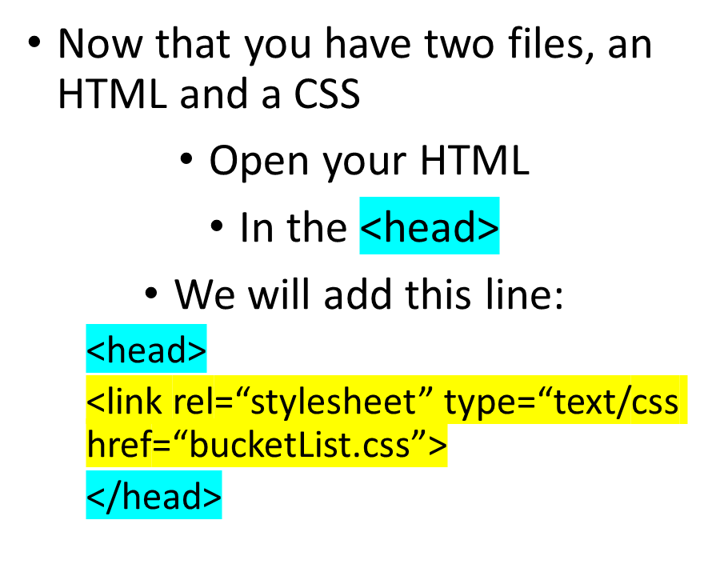
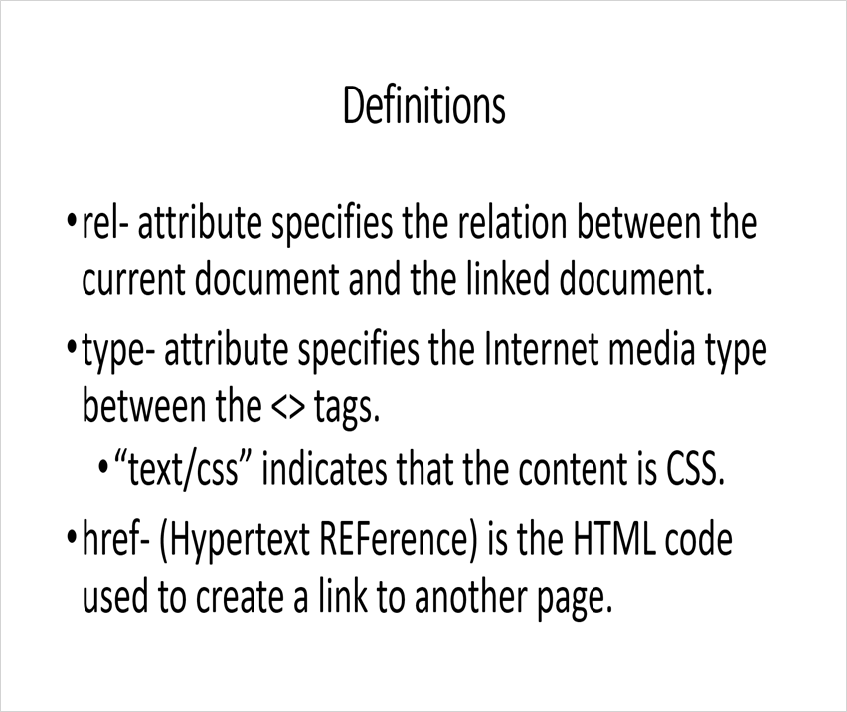
CREATING A WEBPAGE WITH html & CSS

Slide 38
CREATING A WEBPAGE WITH html & CSS
Definitions
rel- attribute specifies the relation between the current document and the linked document.
type- attribute specifies the Internet media type between the <> tags.
“text/css” indicates that the content is CSS.
href- (Hypertext REFerence) is the HTML code used to create a link to another page.

Slide 39
CREATING A WEBPAGE WITH html & CSS
Background
As the name implies you can add background styles to elements in your HTML with CSS.
It can be every element by using html or body as the selector or it can be just one element by using h1 or li.
In keeping things simple, let’s add a full background color to our web page.
Go to your bucketList.css

Slide 40
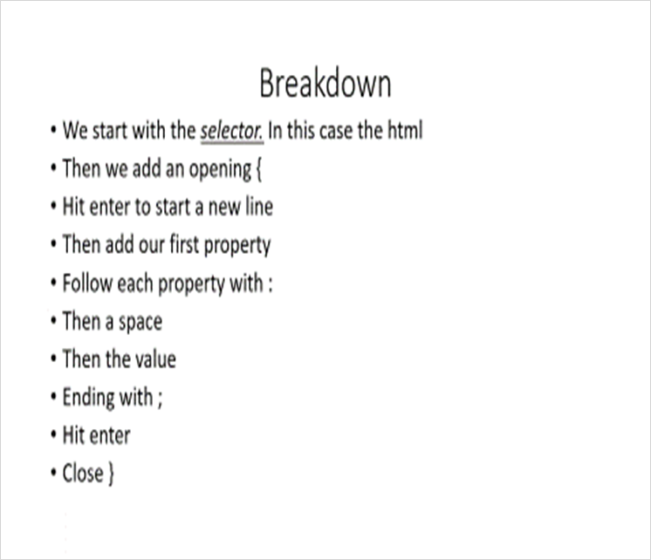
CREATING A WEBPAGE WITH html & CSS
The Code
The code on your CSS should look like this:
html {
background-color: purple;
}

Slide 41
CREATING A WEBPAGE WITH html & CSS
Breakdown
We start with the selector. In this case the html
Then we add an opening {
Hit enter to start a new line
Then add our first property
Follow each property with :
Then a space
Then the value
Ending with ;
Hit enter
Close }

Slide 42
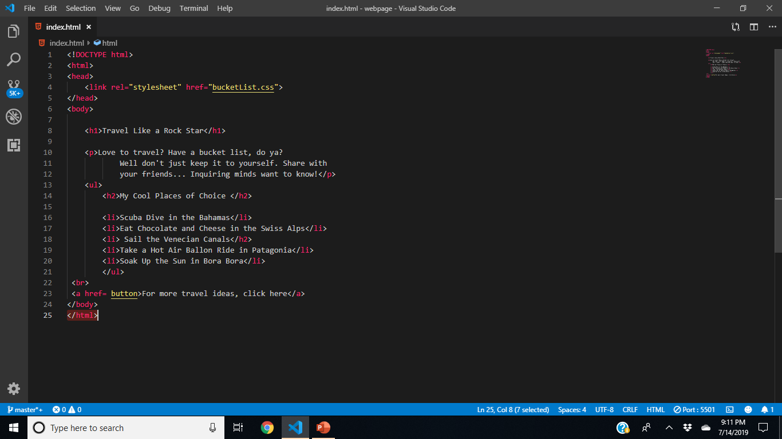
CREATING A WEBPAGE WITH HTML
Notes:
In our webpage example, I have a UL tag with unordered bulleted list items inside of it. So this basically creates a list of items, and then you can use CSS to style that list any way you want.

Slide 43
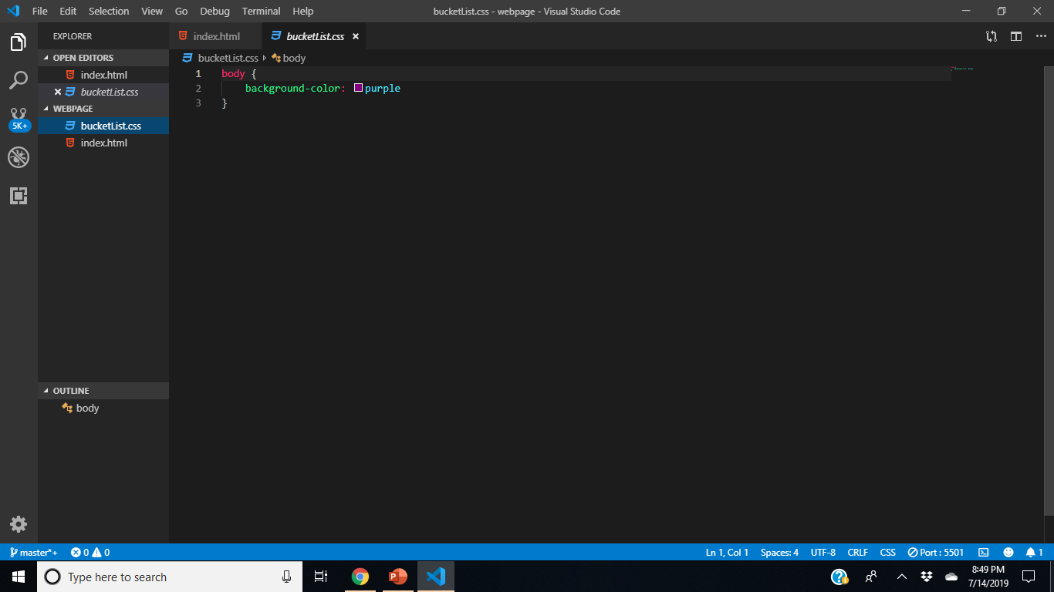

Slide 44
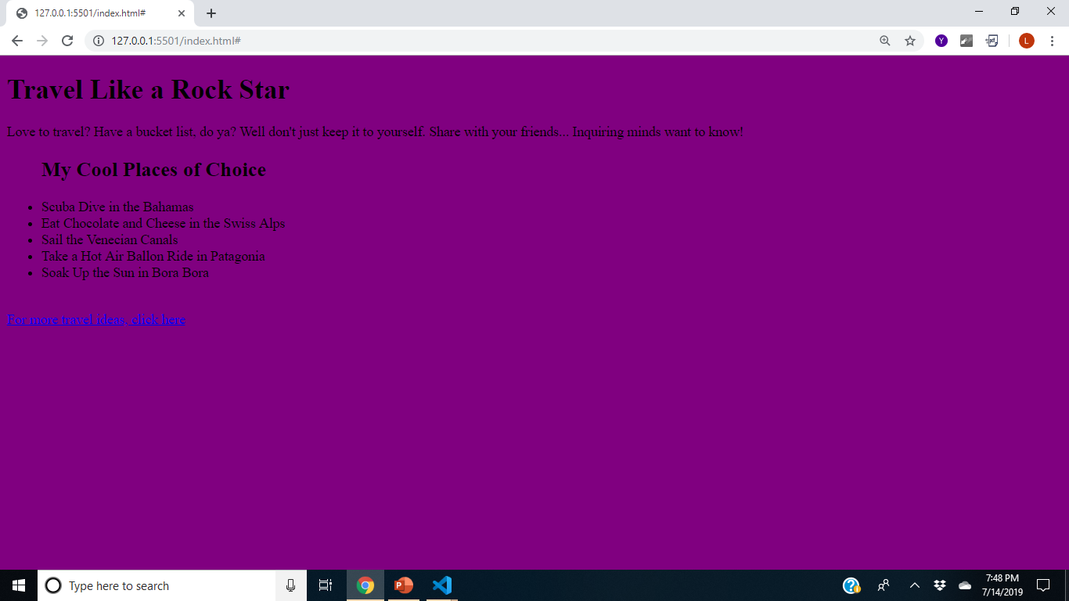

Slide 45
CREATING A WEBPAGE WITH html & css
Font style
Notes:
List and unordered list tags are very important in HTML. These tags are used for things like top navigating on your website. In our webpage example, I have a UL tag with unordered bulleted list items inside of it. So this basically creates a list of items, and then you can use CSS to style that list any way you want.

Slide 46
CREATING A WEBPAGE WITH HTML & css
How to get the font to change
First you must make sure that you have the labeled so that the CSS can identify.
Examples are: <h1> <p> <title>
Notes:
List and unordered list tags are very important in HTML. These tags are used for things like top navigating on your website. In our webpage example, I have a UL tag with unordered bulleted list items inside of it. So this basically creates a list of items, and then you can use CSS to style that list any way you want.

Slide 47

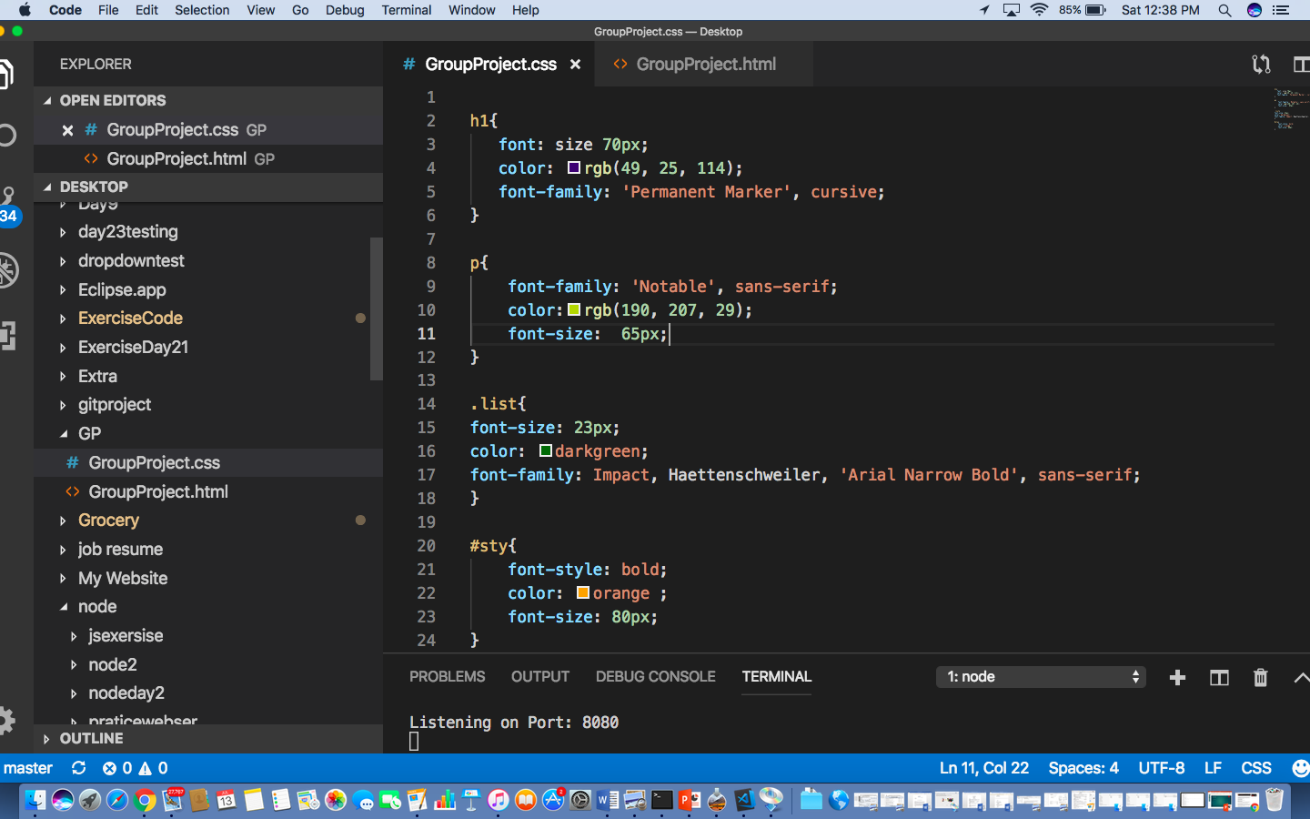
FONT SIZE
In the CSS after you label the name put the font size in the brackets.
Notes:
List and unordered list tags are very important in HTML. These tags are used for things like top navigating on your website. In our webpage example, I have a UL tag with unordered bulleted list items inside of it. So this basically creates a list of items, and then you can use CSS to style that list any way you want.

Slide 48
CREATING A WEBPAGE WITH HTML & CSS
Font color
The Font Color can also be called rgb
Notes:
List and unordered list tags are very important in HTML. These tags are used for things like top navigating on your website. In our webpage example, I have a UL tag with unordered bulleted list items inside of it. So this basically creates a list of items, and then you can use CSS to style that list any way you want.

Slide 49
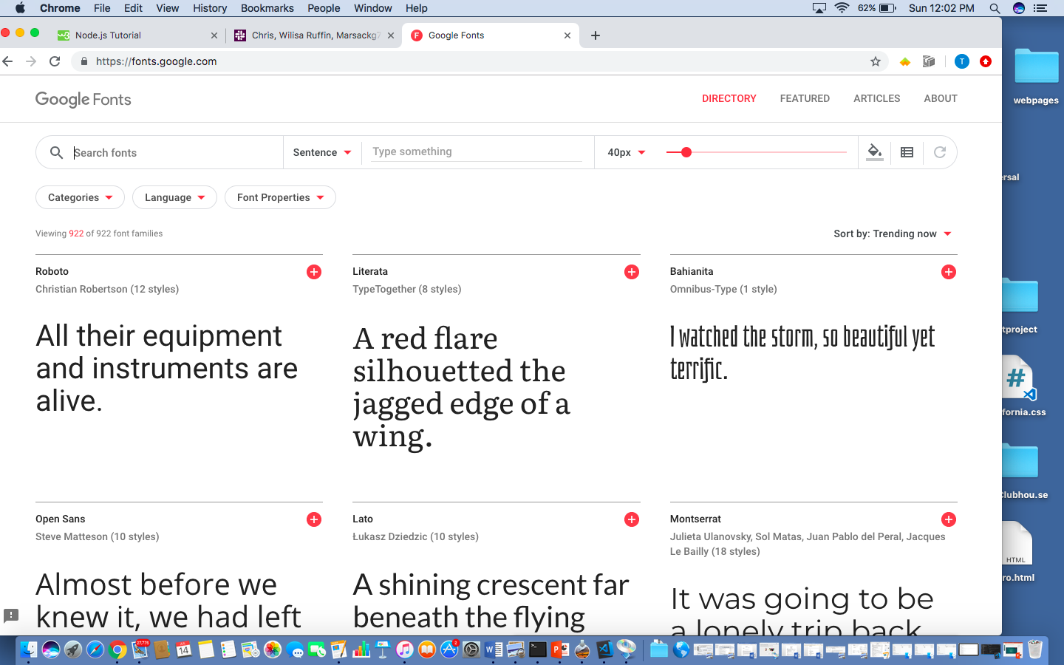
CREATING A WEBPAGE WITH HTML & CSS
Google Fonts
Google Fonts is where you can change the font to different styles, since the Visual Studio code is limited
Notes:
List and unordered list tags are very important in HTML. These tags are used for things like top navigating on your website. In our webpage example, I have a UL tag with unordered bulleted list items inside of it. So this basically creates a list of items, and then you can use CSS to style that list any way you want.

Slide 50
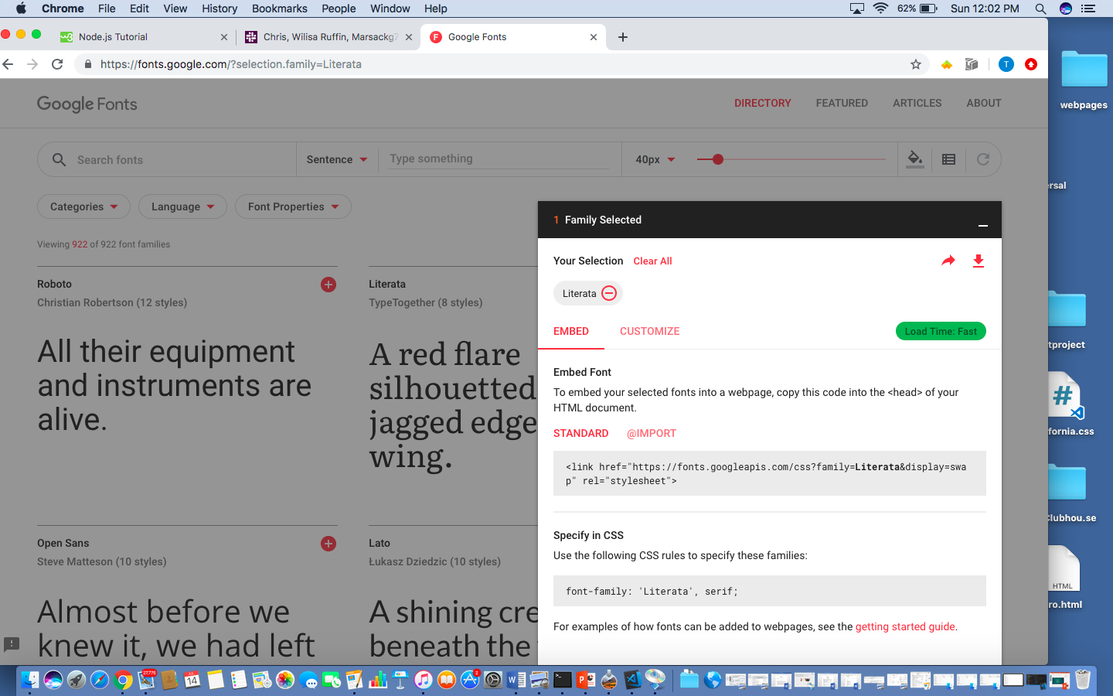
CREATING A WEBPAGE WITH HTML & css
Once you find the one you want import the CSS file.
Notes:
List and unordered list tags are very important in HTML. These tags are used for things like top navigating on your website. In our webpage example, I have a UL tag with unordered bulleted list items inside of it. So this basically creates a list of items, and then you can use CSS to style that list any way you want.

Slide 51
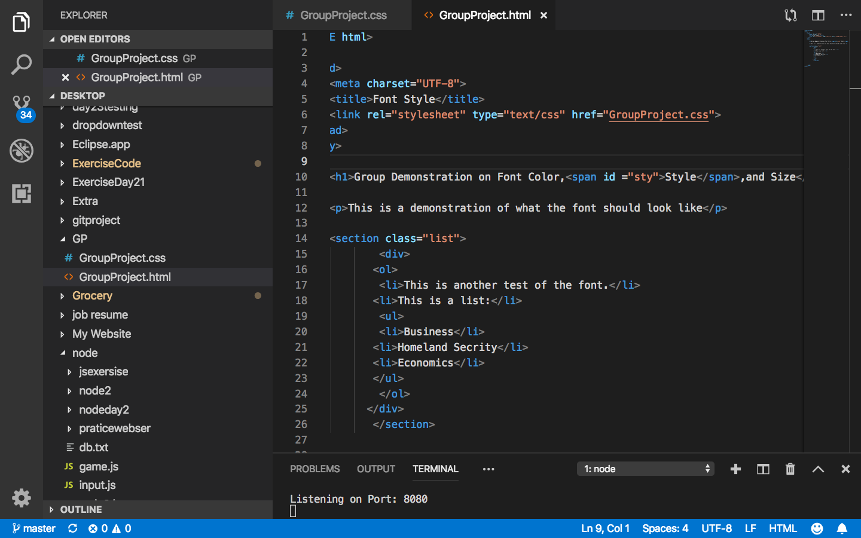
CREATING A WEBPAGE WITH HTML & css
Side Note: ID
The example ”Style is one where you need an ID
Notes:
List and unordered list tags are very important in HTML. These tags are used for things like top navigating on your website. In our webpage example, I have a UL tag with unordered bulleted list items inside of it. So this basically creates a list of items, and then you can use CSS to style that list any way you want.

